Slide 1
IMAGE FORGERY DETECTION
Sarath krishnan
Roll no:24
S6 mca

Slide 2
INTRODUCTION
Today most of the people began to use different image processing techniques to make changes in the images for different purposes
Since it is not easy to differentiate with original image and processed images. The processing of images are called image forging.
To identify such images different methods are developed.

Slide 3
EXISTING SYSTEM
IN Existing system the pixels are compared with other pixels and count the number of similar pixels for finding forgery.
These systems are mainly depending upon the pixel RGB values
leads to inaccuracy
Less efficient

Slide 4
Proposed system
A new framework is proposed to perform multimedia forensics by using compact side information to reconstruct the processing history of a multimedia document
Here we use DCT(Discrete Cosine Transform) to detect forged areas
Copy Move forgery is detected using this system.
It is one of the frequently used techniques to hide or manipulate the content of the image

Slide 5
. Some parts of an image are copied and pasted on other places of the same image.
Duplicated regions are detected using
Block Matching strategy. image is dividing into equal-size overlapped blocks.
Then each block is matched with all other possible blocks in the same image.

Slide 6
ACTORS AND ROLES
USER
USER CAN UPLOAD IMAGE FOR CHECKING FORGERY
USER CAN VIEW THE RESULT
SYSTEM
SYSTEM DETECTS IMAGE FORGERY
SYSTEM SHOWS THE RESULT

Slide 7
MODULE DESCRIPTION
Image Preprocessing - Preprocessing it is defined as advancement of images that conquer the unwanted fragments or improvement of image features.
Grayscale conversion - The image which contains the RGB values are converted into greyscale.
Feature extraction–SIFT features are extracted

Slide 8
Extract Discrete Cosine Features from the blocks
The feature vectors are lexicographically sorted
Comparison -Successfully matched blocks are taken.
Mask the detected areas
Display result

Slide 9
UML DIAGRAMS

Slide 10
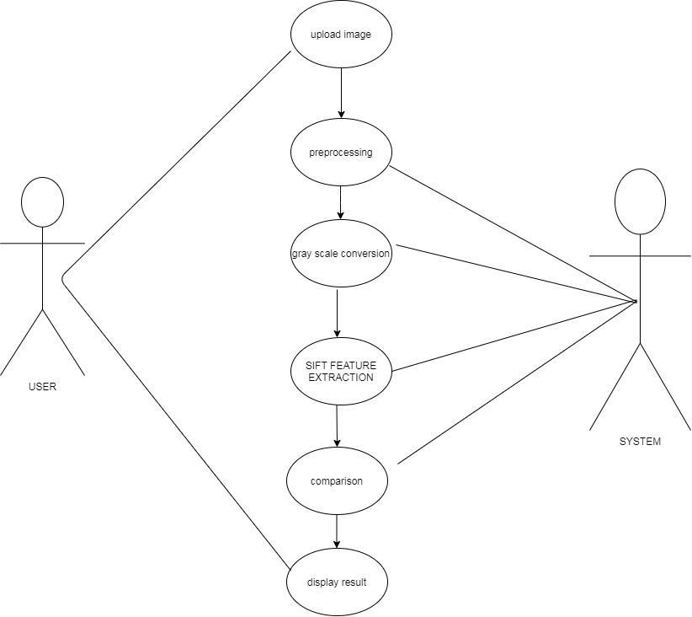
USECASE DIAGRAM

Slide 11
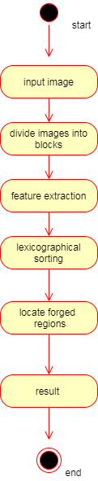
ACTIVITY DIAGRAM

Slide 12
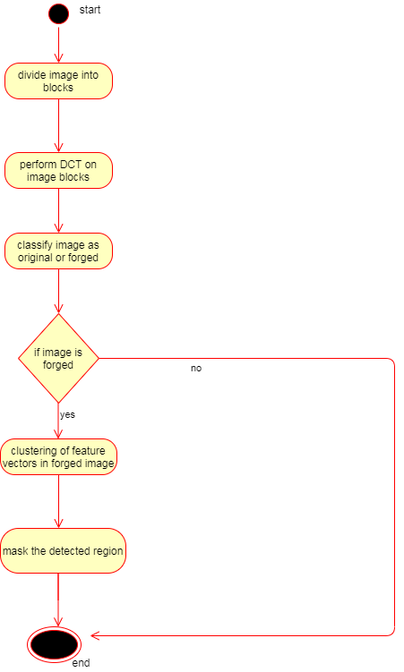

Slide 13
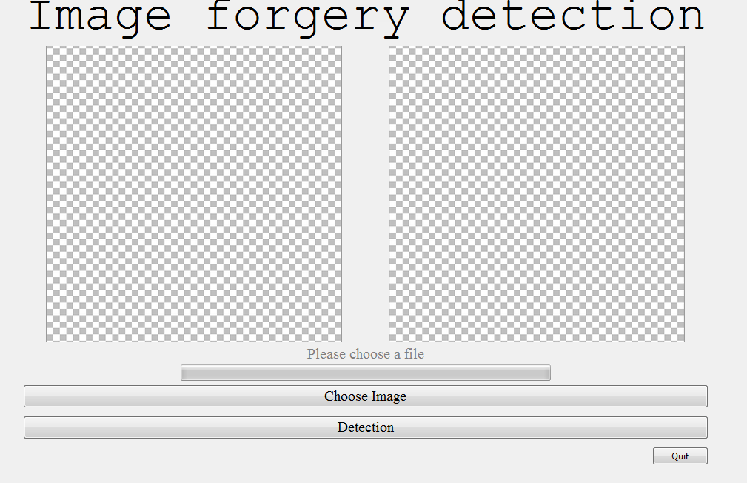
Screenshots

Slide 14
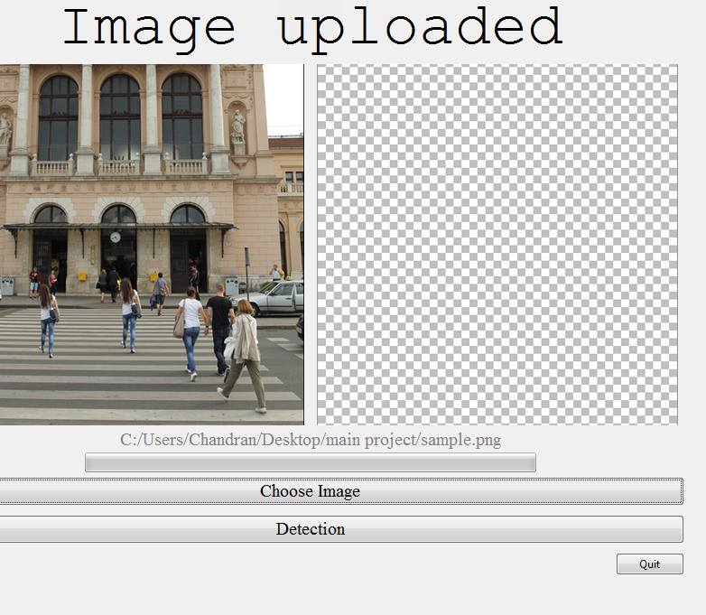

Slide 15
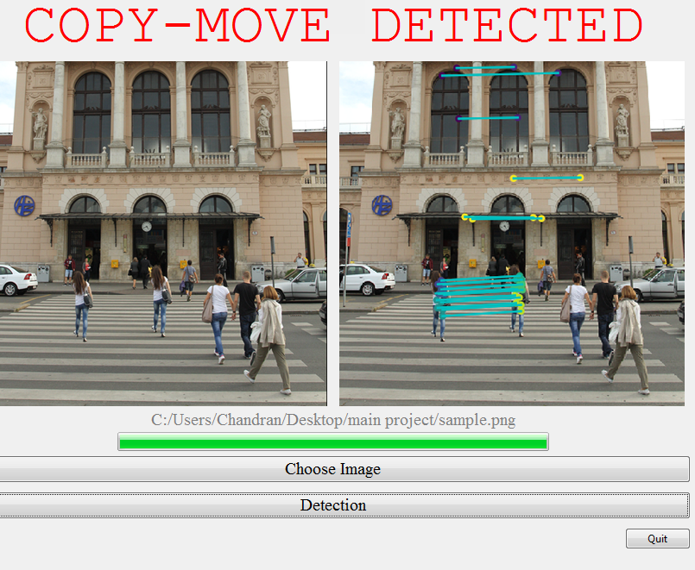

Slide 16
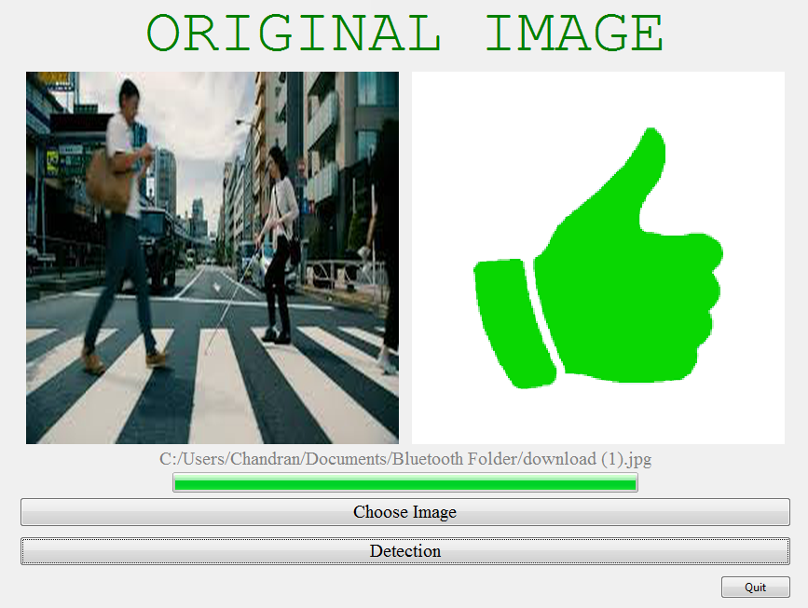

Slide 17
UNIT TESTING
SL NO | PROCEDURE | EXPECTED RESULT | ACTUAL RESULT | STATUS
1 | input image | Determine whether forged or not | forged or not | PASS
2 | Input forged image | Determine forgery | Determine forgery | pass
3 | Input original image | Determine as original | Determine as original | pass

Slide 18
INTEGRATION TESTING
SL NO | PROCEDURE | EXPECTED RESULT | ACTUAL RESULT | STATUS
1 | CHECK WHETHER INTERFACE DISPLAY CORRECT OUTPUT | DISPLAY OUTPUT AS FORGED IF IMAGE IS FORGED OR DISPLAY ORIGINAL IMAGE | DISPLAY OUTPUT AS FORGED IF IMAGE IS FORGED OR DISPLAY ORIGINAL IMAGE | PASS

Slide 19
FUTURE SCOPE
The method is to be improved for detecting duplicated region under the influence of severe geometric transformations such as rotation with large angels, scale…etc.

Slide 20
THANK YOU

